Slide 1
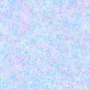
Rainbows
Name
Institutional Affiliation
Course
Instructor
Date

Slide 2
Definition
A rainbow refers to a natural phenomenon noted for its design and place across the sky.
In essence, it is a multicolored arc that forms in the sky made by light from the sun striking water droplets (Tarlach, 2019).
They are meteorological phenomena resulting from refraction, reflection, and dispersion of light in rain droplets, forming a spectrum of colors forming in the sky at the opposite side of the sun.
Notes:
This representation focuses on rainbows. Many of us may have seen a rainbow in our lives. In definition, a rainbow refers to a natural phenomenon noted for its design and place across the sky. In other words, it is a multicolored arc that forms in the sky made by light from the sun striking water droplets. Fundamentally, they result from refraction, reflection, and dispersion of light in rain droplets, forming a spectrum of colors forming in the sky at the opposite side of the sun.

Slide 3
Discovery
A Greek Philosopher, Aristotle, first discovered the rainbow where he started talking about rainbows and their beautiful colors back in 350 BC (Pivarski, 2011).
His ideas were then developed and elaborated by different philosophers, including Seneca the Younger, a Roman philosopher in his book 1 of Naturales Quaestiones in 65 AD.
Seneca’s reasoning was much more advanced, and he discovered the prism effect, which was studied and expounded by Newton centuries later.
Different philosophers, thinkers, and naturalists examined the phenomenon of the rainbow effect throughout history, analyzing its appearances on the sky and other circumstances such as art and literature.
Notes:
The rainbow was first discovered by a Greek Philosopher, Aristotle, who started talking about rainbows and their beautiful colors back in 350 BC. His ideas were then developed and elaborated by different philosophers, including Seneca the Younger, a Roman philosopher in his book 1 of Naturales Quaestiones in 65 AD. Seneca also discovered the prism effect, which was later studied and expounded by Newton. Over time, different philosophers, thinkers, and naturalists have examined the phenomenon of the rainbow effect throughout history, analyzing its appearances on the sky and other circumstances such as art and literature.

Slide 4
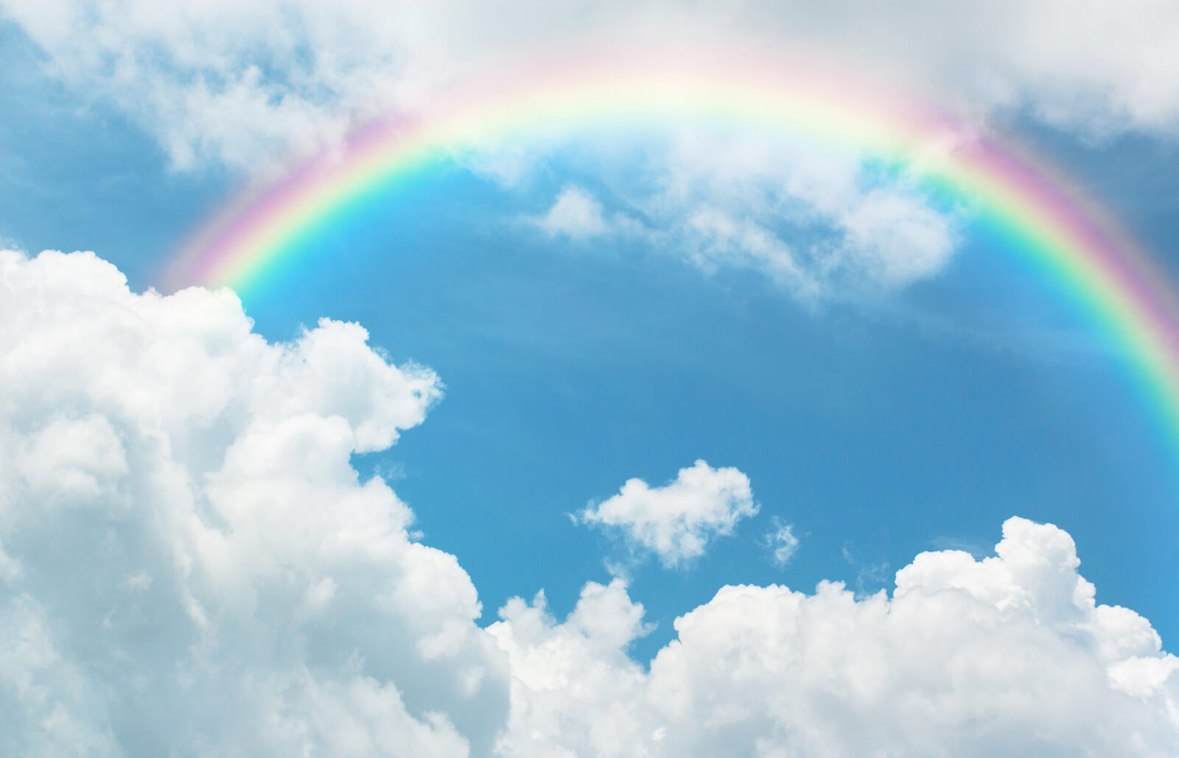
A view of the rainbow

Slide 5
Colors of the Rainbow
The rainbow is mainly known to have seven colors. The colors include red, orange, yellow, green, blue, indigo, and violet (Bikos, 2020).
Red represents the longest wavelength, while violet represents the shortest wavelength in the sequence.
Nonetheless, further inspection and studies about the rainbow show that there are more than seven individuals hues.
Rainbow is not a pure spectrum. Rather, it is formed by a myriad of individual spectral colors that have mixed and overlapped.
Notes:
The rainbow has beautiful colors which mainly include red, orange, yellow, green, blue, indigo, and violet. Red represents the longest wavelength, while violet represents the shortest wavelength in the sequence. It is crucial to add that, further inspection and studies about the rainbow show that there are more than seven individuals hues.
Rainbows are not pure spectrums. Rather, it is formed by a myriad of individual spectral colors that have mixed and overlapped.

Slide 6
How the Rainbow is formed
A rainbow forms in the sky when the sunlight passes through a water droplet. As light hits the droplet, it bends or refracts at an angle. Light travels slower in water than in air as the water is denser (Tarlach, 2019).
The light then bounces off at the back of the droplet and going back in the direction it came from. It bends again as it speeds up when exiting the water droplets.
Notes:
Many of us may have seen a rainbow but not many clearly understands how it is formed. A rainbow forms in the sky when the sunlight passes through a water droplet. As light hits the droplet, it bends or refracts at an angle. This is because light travels slower in water than in air as the water is denser. The light then bounces off at the back of the droplet and going back in the direction it came from. It bends again as it speeds up when exiting the water droplets, forming the rainbow.

Slide 7
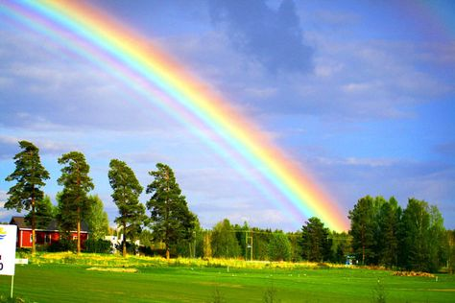
A view of the rainbow over the trees

Slide 8
Rainbows in Culture
Different individuals have varying meanings and perceptions of the rainbow based on their cultures.
In religion, the rainbow has various legends due to its beauty and unexplained phenomenon about its formation.
For instance, in Chinese mythology, the rainbow was a slit in the sky sealed by a Nuwa, a goddess, using colored stones.
In the Bible’s flood narrative, after God washing away humanity’s corruption, He created the rainbow as a sign of the promise that He would never flood the earth again (Palmer, 2020).
The rainbow is also used in religious art and romantic landscape art, films, literature such as books. Rainbow in flags acts as a sign for a new era, social change, and hope.
Notes:
Different individuals have varying meanings and perceptions of the rainbow depending on their cultures. In religion, the rainbow has various legends due to its beauty and unexplained phenomenon about its formation. The Chinese mythology beliefs that the rainbow was formed by a goddess, Nuwa, when sealing a slit in the sky using different colored stones. The Bible’s flood narrative is most common where individuals believe that it is a promise from God that He would never flood the earth again. The rainbow is also used in religious art and romantic landscape art, films, literature such as books. Rainbow in flags acts as a sign for a new era, social change, and hope.

Slide 9
Conclusion
A rainbow is a natural phenomenon that forms in the sky, mostly after it rains. It is caused by refraction, reflection, and bouncing of light in a water droplet.
While rainbows are just seen in the sky, they play a significant role in people’s lives as it is integrated into different aspects of lives and culture, including art, literature, films, and flags as a symbol of hope and new beginnings.
Notes:
As I conclude, I would like to restate that a rainbow is a natural phenomenon that forms in the sky, mostly after it rains. It is caused by refraction, reflection, and bouncing of light in a water droplet. While rainbows are just seen in the sky, they play a significant role in people’s lives as it is integrated into different aspects of lives and culture, including art, literature, films, and flags as a symbol of hope and new beginnings.

Slide 10
References
Bikos, K. (2020). What are rainbows? timeanddate.com. https://www.timeanddate.com/astronomy/rainbow.html
Palmer, P. (2020, September 16). The beautiful and lasting symbol of the rainbow. Crosswalk.com. https://www.crosswalk.com/faith/bible-study/the-beautiful-and-lasting-symbol-of-the-rainbow.html
Pivarski, J. (2011). The discovery of rainbows. Coffeeshop Physics. https://coffeeshopphysics.com/articles/2011-10/30_the_discovery_of_rainbows/
Tarlach, G. (2019, April 22). Twenty things you didn't know about rainbows. Discover Magazine. https://www.discovermagazine.com/planet-earth/20-things-you-didnt-know-about-rainbows

