Slide 1
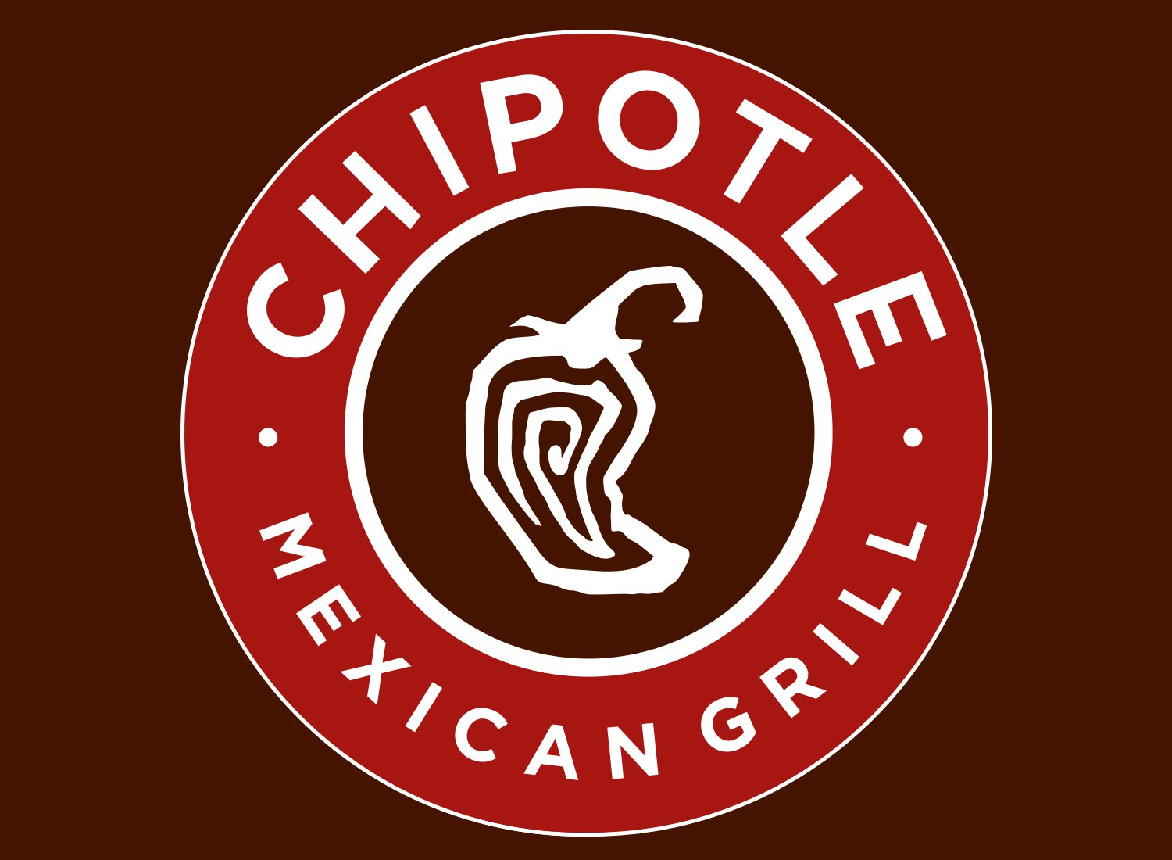
Chipotle Mexican Grill, Inc.
Analysis of Competitive Methods Used By the Company in the Last Four Years

Slide 2
Technology
Existing Technology New Technology
SCHEDULING SOFTWARE
DIGITAL TABLE MANAGERS
DIGITAL INVENTORY TRACKING
MOBILE ORDERING TECHNOLOGY
AI-POWERED ORDERING SYSTEM
BLUETOOTH TEMPERATURE SENSORS
VIRTUAL REALITY ONBOARDING
COUNTER-PLACED AUTOMATED ORDERING TOOL
TABLETOP TABLETS
VIRTUAL FARMER’S MARKET
NUTRITION CALCULATOR
Notes:
The fast-casual restaurant chain Chipotle has invested greatly in new technology and hopes to commit more resources in technology in the future. Some of the existing technologies that chipotle has are real-time scheduling software, digital table managers and digital inventory tracking software and hardware. Chipotle also has mobile ordering technology which allows customers to order meals and enjoy delivery from the comfort of their homes and offices smartphones. Furthermore, chipotle has an AI-powered ordering system that predicts items of the menu once a customer orders a product. For instance, in the customer specific-area where consumer order meals, the system can order your favorite meal with one click without you choosing from the menu; the system knows what you want.
On the other hand, chipotle has prospective new technology that has been designated as the next competitive and expansion strategies through technology. The new technology include Bluetooth temperature sensor. Bluetooth temperature sensors sense the temperature in the food storage ware, cooking equipment and alerts the personnel involved to take early action. This present the food from going bad. Other new technology include virtual reality onboarding which allows consumer and new employees to interrelate efficiently an build long-lasting relationships, counter-placed automated ordering system and tabletop tablets for ordering, menu display and payments. Virtual farmers market allows chipotle to relate with farmers more efficiently and aids in scheduling purchases. On the other hand, a nutrition calculator enables the staff and the customer determine the amount of nutrients and content in the food they eat and gives them control.

Slide 3
Branding & Marketing Campaign
branding and marketing campaigns concentrate on product quality and customer satisfaction
chipotle promoted a 'food with integrity' motto, which spelled out the nutrition in their menus
gives free burritos to top athletes and hosts free festivals to generate local awareness
Notes:
In chipotle, the branding and marketing campaigns concentrate of product quality and customer satisfaction. Product quality creates a unique value proposition and ranks chipotle as a quality food fast-casual restaurant. Customer satisfaction is essential as in aids in increasing the customer acquisition and retention rate. Chipotle informs the consumer about the nutrition and content of their food by promoting the “Food with Integrity” motto. This motto gives the organization authenticity and wins the trust of consumers. As a promotional strategy, chipotle gives out free burritos to top athletes and hosts free festivals to generate more awareness of their brand. The free festivals are essential fro branding because the items given out are branded and also, the consumer view the free festivals as corporate social responsibility.

Slide 4
Restaurant Set-Up Design, Business Structure, and Strategic Profiles
Setup and design functions with the minimizing “wasted space model”
seated customer can have a view of the kitchen
Walk up windows and drive-through set up
Chipotle, in most cases, owns the stores they operate, this means that they have reduced rent and leasing expenses.
As a competitive advantage, Chipotle is moving towards purchasing more real estate
Notes:
The setup and design of chipotle is focused on minimizing wasted space. The space saving model ensures that customers and workers engaged smoothly with minimal obstacles at chipotle restaurant and enables the customer to have a view of the kitchen. . Due to the space saving model and the technology invested at chipotle the restaurant experience is digitalized and modernized. It is modernized because it no longer applies the traditional restaurant setup. One of chipotle strategic characteristic is that they uphold hospitality as a customer service and throughput that places production effort equivalent to outcomes. More so, chipotle exercises displace in their economic model in that output always outmatches input. Chipotle also keeps innovation across its menus by introducing new products which also improves restaurant experience for its customers and itself. Chipotle practices cultural relevancy in it locations such as introducing restaurant menus and displays that appreciate community-specific culture. They also, try to blend in the Mexican culture in the menus to give them authenticity. Such a strategic idea increase brand loyalty across all its locations. As a new strategic move, chipotle in the recent year have introduced walk-up windows and drive through for people to pick up and pay for their order on the go in most of its location and hopes to do so in all its stores. Chipotle owns most of its stores as a strategy to reduce leasing and rent expenses and they are moving towards buying more real estate for store expansion, international expansion and other related investments.

Slide 5
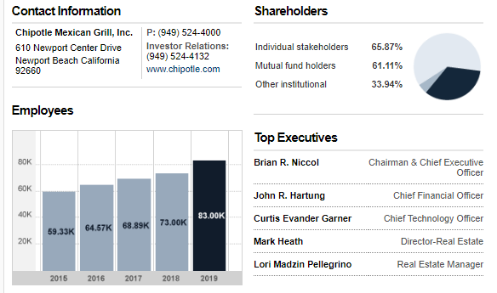
Shareholder information
LIMITED LIABILITY CORPORATION WITH ALL ITS SUBSIDIARIES
(CNN Business, 2020).
Notes:
Chipotle is a limited liability company with all its subsidiaries. In terms of shares in chipotle, 65.87% are individual shareholders, 61.11% are mutual funds holders and 33.94% shares are owned by other institutions. As of 2019, chipotle had 83,000 employees. The top executive for chipotles include Brian Niccol as the CEO, John Hartung as the Chief Financial Officer Curtis Garner as the Chief Technology Officer, Mark Heath as the Director of Real estate and Lori Pellegrino as the real estate manager.

Slide 6
Competitive Methods
GLOBALIZATION
RESTAURANT-EXPERIENCE DIGITALIZATION
MODERNIZATION
VIDEO MARKETING
INTERNATIONAL EXPANSION STRATEGIES
STORE EXPANSION
SPECIALIZING IN CULTURALLY DIVERSE CUISINES
NEW PRODUCTS LAUNCH SUCH AS STEAK, BARBACOA ITEMS, NACHOS, AVOCADO TOSTADAS, AND UPDATED SALAD AND CHOCOLATE MILKSHAKES
INTERNATIONAL INVESTMENTS
SELLING HEALTH MEALS
OFFERING FOOD WITH INTEGRITY
PARTNERSHIPS WITH FOOD DELIVERY SERVICES
USING SUSTAINABLE AND ENVIRONMENTALLY FRIENDLY INGREDIENTS
Notes:
Competitive methods for Chipotle are extensive in such a way that the organization can be considered as aggressively competitive. One of the competitive methods is globalization through establishment of a wide network of suppliers globally. Restaurant experience and digitalization have also attracted modernized and digitalized consumers. Video marketing through platforms such as you tube and Vimeo and in ads has also been an agile competitive method for chipotle. International expansion and store expansion strategies such as opening new stores in new regions has increased their geographical presence, store size and market penetration. Chipotle also specializes in culturally diverse cuisines integrated into its globalization strategy and thus they have gained acceptance in many markets internationally.
chipotle also boost its competitiveness by new product launches to increase the product category and increase customer segments, new products include Steak, Barbacoa items, Nachos, Avocado Tostada and updated salad and chocolate milkshakes. International investments, a competitive method for chipotle, involves acquisition of foreign assets, mergers, acquisitions and buying shares from other competitors. Also chipotle is known for its health meals which is a unique selling proposition backed up by the :selling food with integrity” motto. Chipotle has also boosted its competitiveness by partnering with food delivery service providers such as Uber eats for efficient customer service and experience. In addition, chipotle uses sustainable and environmentally friendly ingridients thus giving them originality and makes the environmental conscious.

Slide 7
Competitive Strategy in the Last 4 Years
GLOBALIZATION
VIDEO MARKETING
INTRODUCING NEW BRANDS (SHOPHOUSE AND PIZZERIA LOCALE)
SELLING MEXICAN MENUS
HANDMADE FOOD
NEW PRODUCTS: STEAK, BARBACOA ITEMS, NACHOS, AVOCADO TOSTADAS, AND UPDATED SALAD AND CHOCOLATE MILKSHAKES
Notes:
In the last four year, chipotle has executed some competitive strategies that have resulted to greater market penetration, increased customer retention rate and increased market share. Globalization, as one of the competitive moves, means that chipotle was able to integrate more suppliers from different parts of the world, serve menus that are globally accepted, distribute its chain across the globe and integrate cultural spheres which expand the market. Another competitive strategy that chipotle has used is video marketing via production of promotional videos and ads presented in their website and video platforms such as YouTube and Vimeo. Chipotle introduced new brands as a competitive strategy; the two other brands, an Asian theme restaurant called ShopHouse and Pizzeria Locale. This is a competitive move since the two brands controlled by Chipotle will gain market share, which is directly connected and attributed to Chipotles and eventually increasing Chipotle's market share. Chipotle's competitive profile entails selling Mexican Menus and customized cuisines in its locations as a unique selling proposition. The competitive advantage in this strategy was that it allowed Chipotle to cater for culturally diverse customers and tourists. New products include steak, barbacoa items, nachos, avocado tostadas, and updated salad and chocolate milkshakes. The success of new items as it has been in the last decade for Chipotle means a new item to attract and retain new customers. The new products and Mexican menus also were incorporated with producing handmade food as a competitive advantage aimed at promoting originality which is a characteristic that customers like.

Slide 8
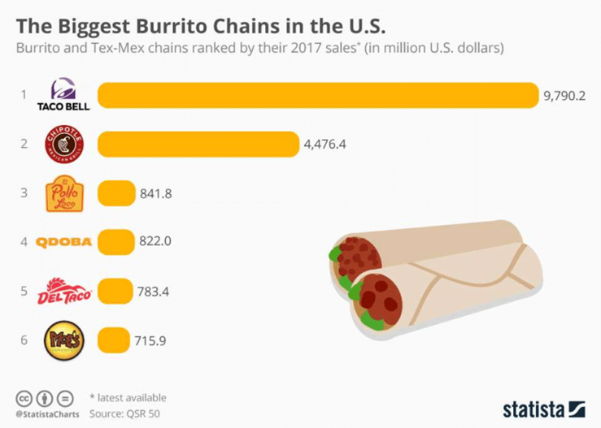
Competitors
TACO BELL
PANERA BREAD
MOE'S SOUTHWEST GRILL
(BUSINESS STRATEGY HUB, 2019)
Notes:
Chipotle is the second largest Burrito vendor in the US after Taco Bell; this toe chains are the racing competitors in the sale of Burritos. The top three competitors of chipotle are Taco Bell, Panera Bread and Moe’s Southwest Grill. Taco bell is present in the US, Asia, Europe, the Middle East, and North America. Panera Bread is based in the US and operates as a fast café brand chain in the US and Canada. Panera Bread menu contains Panini, drinks (tea and coffee), sandwiches, pasta, salads, soup, and Bagels. Moe’s Southwest Grill identifies as an American fast-food chain in the US, Russia and Turkey as franchises. Taco recorded $2.1 billion worth of revenues in 2019 while Panera Bread recorded annual revenues of $2.8 billion in the fiscal year 2017 and Moe's registered revenues of $37.7 million in 2019.

Slide 9
Primary Competitors
DIRECT COMPETITORS
TACO BELL
PANERA BREAD
MOE'S SOUTHWEST GRILL
INDIRECT COMPETITORS
BURGER KING
KFC 2019 (WHAT COMPETITORS, 2020).
Notes:
The top three primary competitors of chipotle are Taco Bell, Panera Bread and Moe’s Southwest Grill as mentioned earlier. Also, other primary competitors that are categorized as indirect are Burger King and KFC. The are considered as indirect because they specialize in fast foods while chipotle operates as a fast-casual restaurant. However, Burger King and KFC are in the same market as Chipotle and thus they compete fro the same customer segments.

Slide 10
Secondary Competitors Statistics
NOTE: THE STATISTICS ARE AS OF 2020 (WHAT COMPETITORS, 2020)
Notes:
Chipotle has a big list of secondary competitors. These competitors are considered as secondary because they do not compete as closely with chipotle as the other primary competitors. Also, these secondary competitors are present in few states. Most of the secondary competitors are located in USA except for Mucho Burrito in Saint-Laurent, Montreal in Canada. Others include Rubio’s Fresh Mexican Grill in Georgia, Del Taco in California, El Pollo Loco in California, Beja Fresh in Arizona, Taco John in Wyoming, On the Border in Texas and Taco Time in Arizona.

Slide 11
Situation Analysis: PESTEL Analysis
POLITICAL FACTORS INCREASE IN THE NUMBER OF INTERNATIONAL TRADE AGREEMENTS DIETARY GUIDELINES FORM THE GOVERNMENT CHANGING PUBLIC HEALTH LAWS. | ECONOMIC FACTORS MODERATE GROWTH IN DEVELOPED COUNTRIES CHINESE ECONOMY SLOWDOWN INCREASED GROWTH IN DEVELOPING COUNTRIES
SOCIAL FACTORS INCREASED CONSUMER DISPOSABLE INCOME URBAN LIFESTYLES RISE IN CULTURAL DIVERSITY TRENDS IN HEALTHY LIFESTYLES | TECHNOLOGICAL FACTORS RESEARCH AND DEVELOPMENT INCREASED BUSINESS AUTOMATION USE OF MOBILE DEVICES IN ORDERING
ENVIRONMENTAL FACTORS INCREASED FOCUS ON CORPORATE ENVIRONMENTAL AGENDAS RISING INTERESTS IN SUSTAINABLE BUSINESS CLIMATE CHANGE | LEGAL FACTORS ANIMAL WELFARE POLICIES ARE ON THE INCREASE WORKPLACE HEALTH REGULATIONS THE LEGAL MINIMUM WAGE IS RISING
Notes:
Chipotle political factors include increased international trade agreements between the UK, the US, Germany, and France thus increasing the geographical market available for expansion. Also, the dietary guidelines form the government affect the menus and ingredients used by chipotle. On the other hand, changing public health laws affect the sales in that a restaurant that has rampant relations with disease outbreak is closely monitored and risks closure.
Economic factors include moderate growth in developed countries which hinder international expansion but still welcome space for its investments and add value to its assets. For instance, Chipotle, in most cases, owns the stores they operate, and this means that they have reduced rent and leasing expenses. Chinese economy slowdown also slows down chipotle since some essential ingredients are sourced from china. On the other hand increased growth in developing countries is an investment opportunity for chipotles as an economic factor
Social factors include increased consumer disposable income, urban lifestyles, and rise in cultural diversity and trends in healthy lifestyles. Increased consumer disposable income, trends in healthy lifestyles and urban lifestyles increases sales for chipotles. Marketing activities such as gifts, event organizing, social media market, and holding free nutrition training camps to the general public makes the consumer aware of the healthiness of the foods Chipotle provides them with. Consumers prefer buying meals and dining in restaurants conscious about their health and who give them a balanced diet in their menus. Cultural diversity is an investment opportunity as it avail a globalization chance for chipotle to increase its product category.
Technological factors in chipotles external analysis include research and development admitting new menus, emerging markets, and customer satisfaction methods to increase customer retention. There is also increased business automation, such and online ordering, payment methods, and reporting. Also, the increased use of mobile devices in ordering ad delivery services has seen Chipotle partner with Uber etas, Grunhub, and Doordash.
Environmental factor are increased focus on corporate environmental agendas, rising interests in sustainable business and climate change. The corporate social responsibility that Chipotle shows have, in the last few years, attracted consumers to it. Consumers feel more loyal to a service and product provider concerned about their wellbeing. Also, chipotle has been using sustainable and environmentally friendly ingredients. Most of this includes affordable foods while they are whole and unprocessed. It eliminates artificial preservatives and focuses on zero-sugar products.
Legal factors entail Animal welfare policies are on the increase, workplace health regulations and the rise in legal minimum wage. Animal welfare refer to policies that encourage consumption of animals reared with ethics and dignity. Also, workplace health regulations might hinder growth of chipotle in that some policy are hard to fulfil in some regions. Chipotle pays all its employees the legal minimum wage, and thus it is compliant with labor laws. Paying your employees minimum wages required and above makes them satisfied and enable them to do their duties with due diligence

Slide 12
Conclusion
Chipotle is a fast-casual dining restaurant chain
It is a Limited liability Corporation with all its subsidiaries
Chipotle Functions with the 'minimizing wasted space' model
Taco Bell, Panera Bread and Moe's Southwest Grill are chipotles top competitors
Competitive methods in the last four years include globalization, video marketing, introducing new brands, selling Mexican menus and new products
Existing technology include scheduling software, digital table managers, digital inventory tracking and mobile ordering technology
Chipotle has the potential to expand into fine dining, casual dining, ghost restaurant, carts, stands and food trucks

Slide 13
References
Business Strategy Hub. (2019, August 20). Chipotle's SWOT Analysis (2019) | Business Strategy Hub. Business Strategy Hub. https://bstrategyhub.com/chipotles-swot-analysis/
CNN Business. (, 2020). CMG - Chipotle Mexican Grill Inc Company Profile - CNNMoney.com. Money.Cnn.Com. https://money.cnn.com/quote/profile/profile.html?symb=CMG
Chipotle. (2020a). Chipotle Announces Partnership With Grubhub To Expand Delivery Footprint. Www.Prnewswire.Com. https://www.prnewswire.com/news-releases/chipotle-announces-partnership-with-grubhub-to-expand-delivery-footprint-301084660.html#:~:text=NEWPORT%20BEACH%2C%20Calif.%2C%20June
Depositphotos, I. (n.d.). ᐈ Advantage stock pictures, Royalty Free competitive advantage photos: Download on Depositphotos®. Retrieved from https://depositphotos.com/stock-photos/competitive-advantage.html
Nick. (2019, April 30). Top 10 Food Delivery Companies in the World 2019. Technavio; Technavio. https://blog.technavio.com/blog/top-10-food-delivery-companies
Reuters Editorial, R. (2020). CMG - Chipotle Mexican Grill, Inc. Profile | Reuters. Www.Reuters.Comundefined. https://www.reuters.com/companies/CMG
Reuters. (2018, April 30). Chipotle partners with DoorDash for food delivery. Reuters. https://www.reuters.com/article/us-chipotle-delivery-doordash-idUSKBN1I12BL
Shaw, A. (2020, February 8). Top 11 Chipotle Competitors and Alternatives. Marketing Tutor. https://www.marketingtutor.net/chipotle-competitors/
Stockrow. (2020). chipotle Mexican Grill, Inc.: Balance Sheet. Stockrow.Com; stockrow.com. https://stockrow.com/CMG/financials/balance/quarterly
Sling. (2019, November 11). 10 Types Of Restaurants: The Complete Guide For Potential Owners. Sling. https://getsling.com/blog/types-of-restaurants/
What Competitors. (2020). Top 10 Chipotle Competitors In 2020 - What Competitors. Whatcompetitors.Com. https://whatcompetitors.com/chipotle/
Yahoo Finance. (2020). Chipotle Mexican Grill, Inc. (CMG) Company Profile & Facts - Yahoo Finance. Finance.Yahoo.Com. https://finance.yahoo.com/quote/CMG/profile?p=CMG
Bloomberg Quicktake (Director). (2016, February 2). The Complete History of Chipotle, in 3 Minutes [Video file]. Retrieved from https://www.youtube.com/watch?v=LKmZ257MFo8&amp;feature=youtu.be
Myers, D. (2016, February 12). Here Are 12 Ways Chipotle Is Trying to Win Back Our Trust. Retrieved November 15, 2020, from https://www.thedailymeal.com/eat/here-are-12-ways-chipotle-trying-win-back-our-trust-slideshow/slide-13

